Slide 1
Midterm project
Chenxi Xu

Slide 2
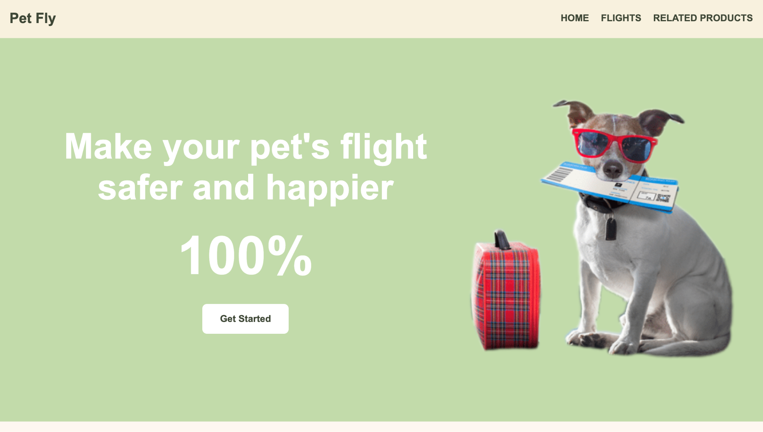

Slide 3
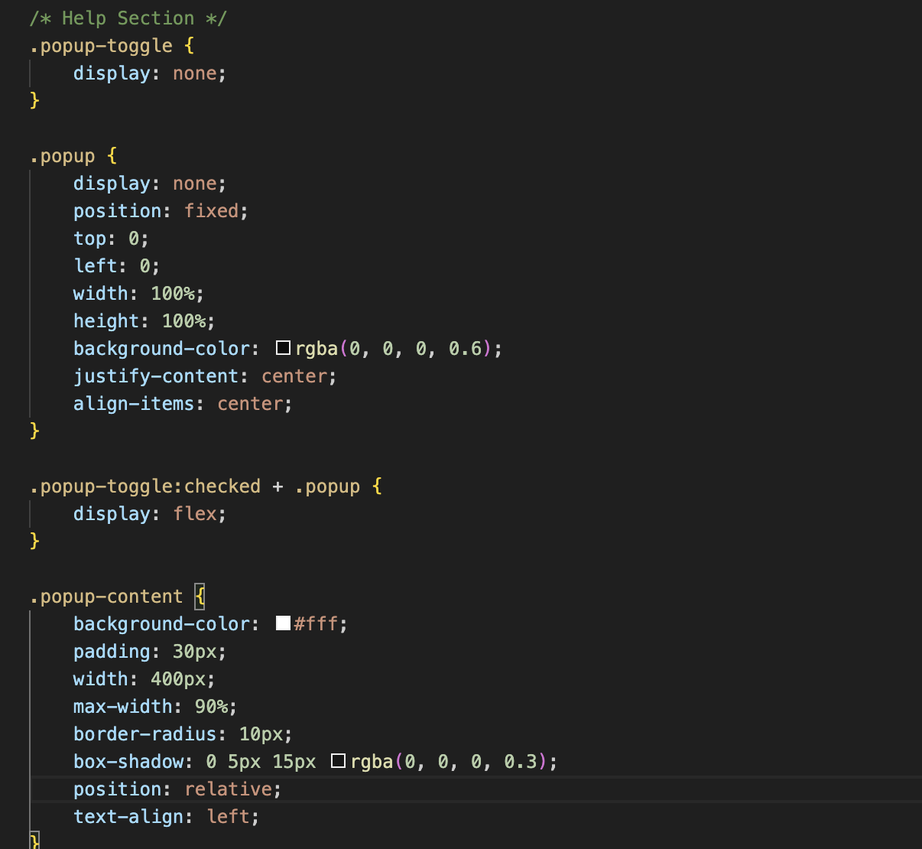
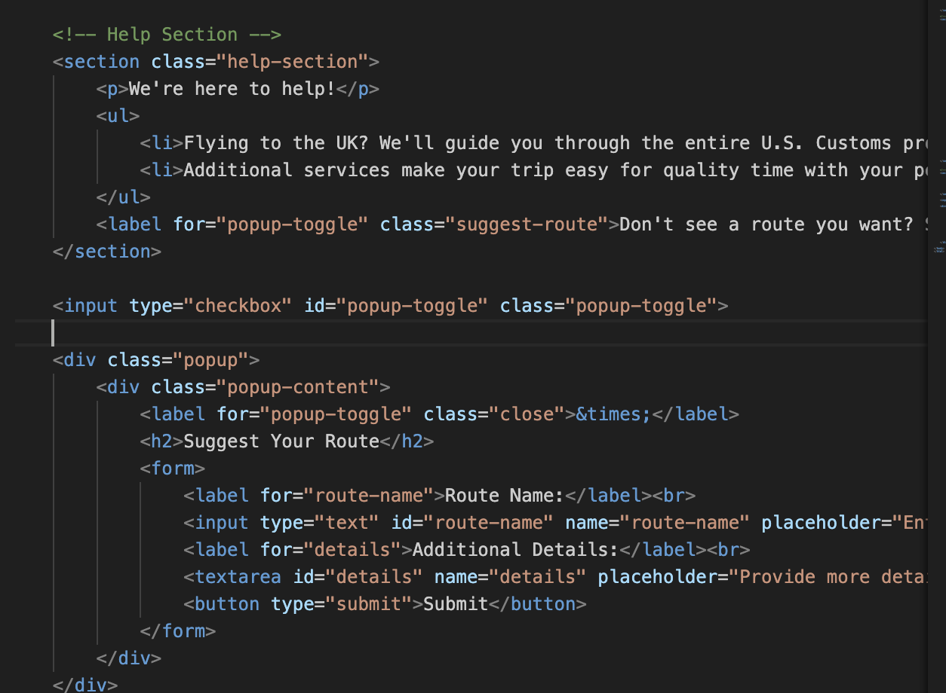
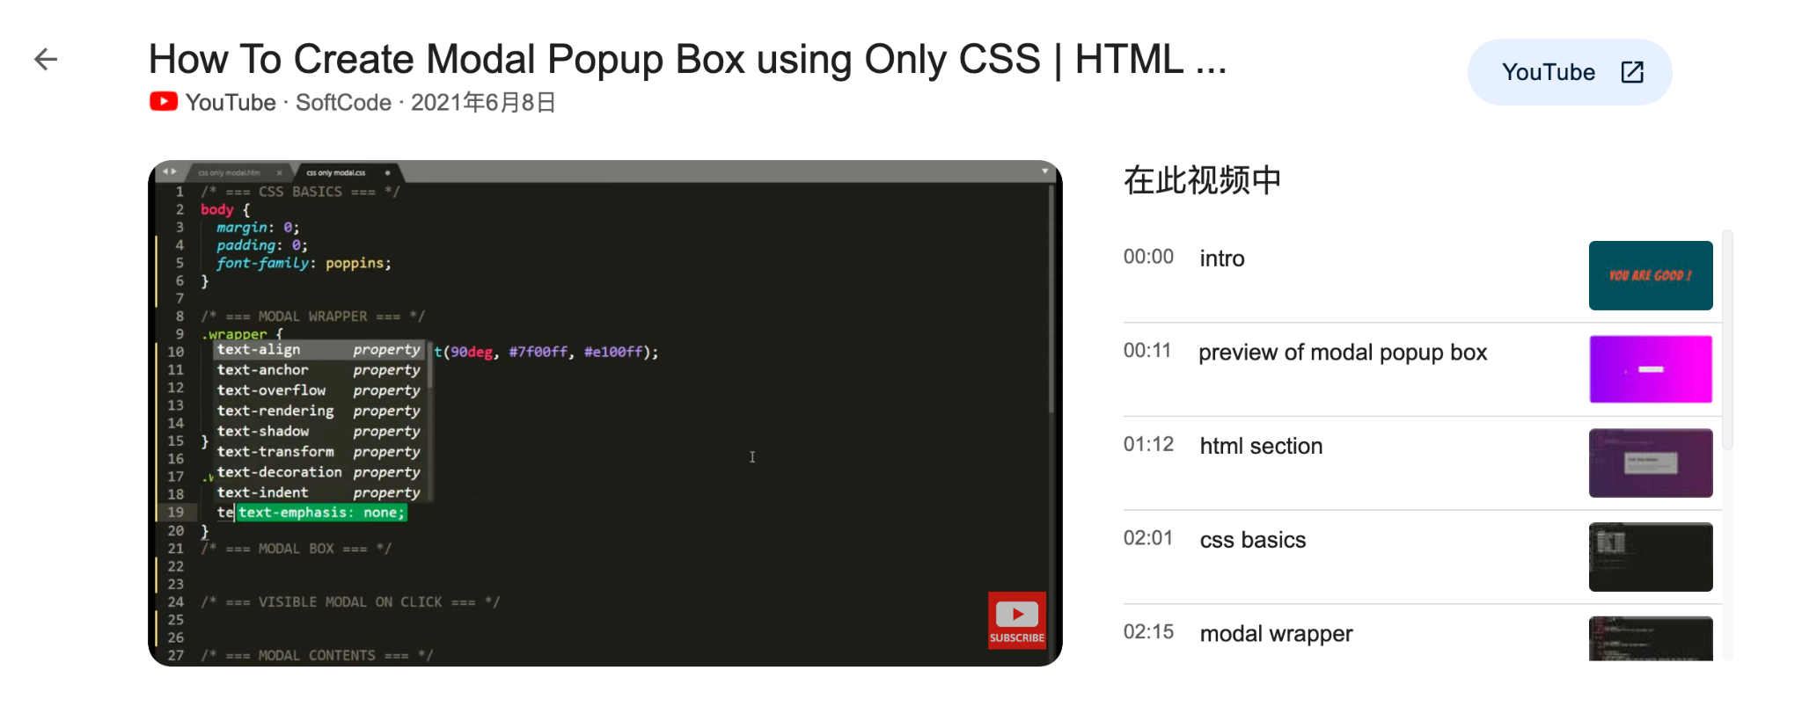
tutorial

Slide 4
I will add more animation.
I will include more information.
I plan to change the appearance of the cursor.
I want to make the boxes clickable.

Slide 5
Thank you!!!

